Slide 1
Introduction to Algorithms and Algorithm Analysis
Based on the slides of Young CS 331 D&A of Algo. Topic: Introduction
w/ content from Analysis of Algorithms cs.purdue.edu

Slide 2
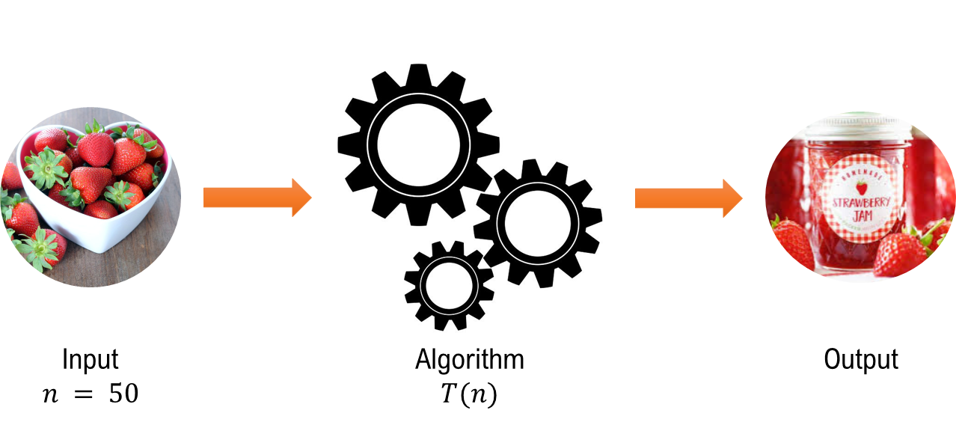
What is an algorithm?
A simple, unambiguous, mechanical procedure to carry out some task.
Why algorithm instead of program?
Writing an algorithm is simpler (we don’t need to worry about the detailed implementation, or the language syntax).
An algorithm is easier to read than a program written in, for instance, C.

Slide 3
How to represent an algorithm?
Give a description in your own language, e.g. English, Spanish, …
2. Pseudo code
3. Graphical

Slide 4
Example – multiplying two positive integers A and B
For example: 45*19
Usually:
45
19 (x
405
45 (+
855

Slide 5
A different algorithm:
Multiplier Multiplicand Result
(A/2) (B*2) (pick numbers in column 2 when the corresponding number under the multiplier is odd)
45 19 19
22 38
11 76 76
5 152 152
2 304
1 608 608 (+
855

Slide 6
An instance of a problem is a specific assignment of values to the parameters.
This algorithm can be used for multiplying any two positive integers, we say that (45, 19) is an instance of this problem. Most problems have infinite collection of instances.
It’s ok to define the domain (i.e. the set of instances) to be considered, and the algorithm should work for all instances in that domain.
Although the above algorithm will not work if the first operand is negative, this does not invalidate the algorithm since (-45, 19) is not an instance of the problem being considered.

Slide 7
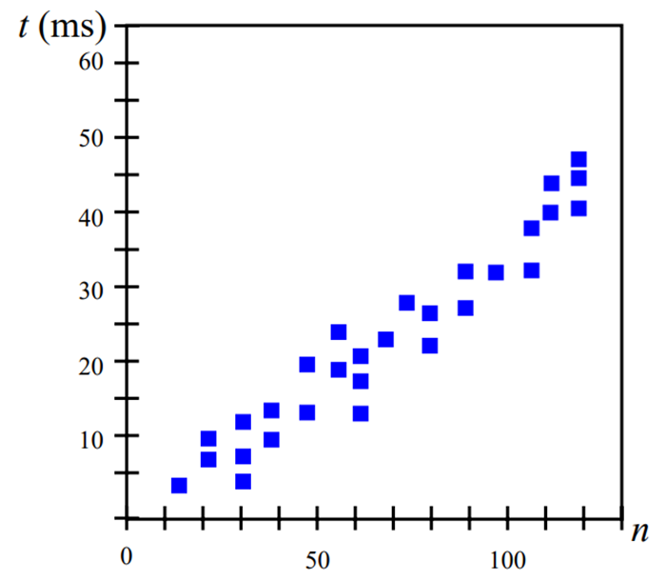
How to measure the running time of an algorithm?
- Experimental Study
- Theoretical Analysis
In experimental study, write the program that implements the algorithm. Then run the program with datasets of varying size and composition. Use a method like #include<chrono> methods to get accurate measure of actual running time. Show the resulting data like shown below.

Slide 8
Experimental studies have limitations:
Algorithm must be implemented to test its running time.
Experiments can only be performed on limited set of inputs.
Comparison will be dependent on computing environment.
Instead, we also use general methodology of theoretical analysis:
Use high-level description over implementation.
Consider all possible inputs.
Evaluate efficiency that is agnostic to computing environment.

Slide 9
Order:
Usually we use the frequency count to compare algorithms.
Consider the following 3 programs:
(a) (b) (c)
x ← x + y for i ← 1 to n do for i ← 1 to n do
x ← x + y for j ← 1 to n do
end x ← x + y
end
end
The frequency count of stmt x ← x + y is 1, n, n².
No matter which machine we use to run these programs, we know that the execution time of (b) is n times the execution time of (a).

Slide 10
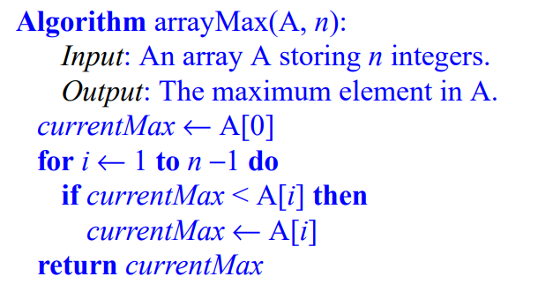
Pseudo-code is a description of an algorithm that is more structured than usual prose but less formal than a programming language.
Example: Find the maximum element of an array
Pseudo-code is our preferred notation for describing algorithms. However, pseudo-code hides program design issues.

Slide 11
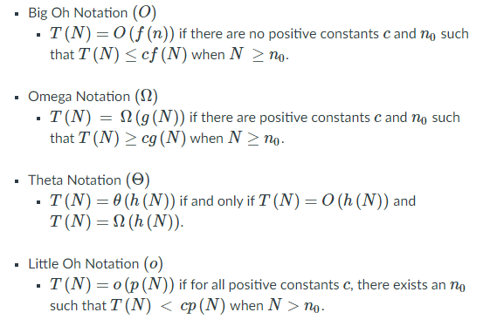
What are the asymptotic notations?
These asymptotic notations are used to describe the running time of a given algorithm when the input approaches a particular or limiting value. These are:

Slide 12
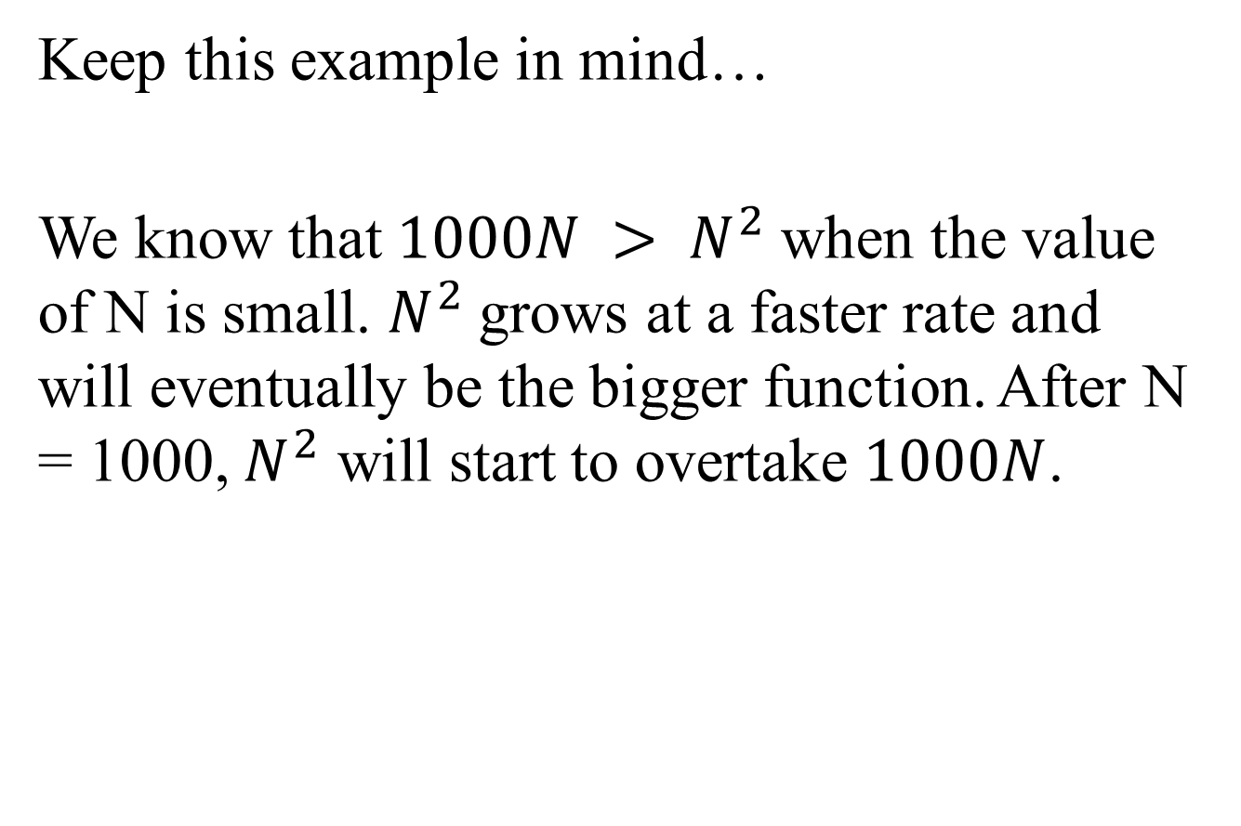
Keep this example in mind…
We know that $1000N > N^{2}$when the value of N is small. $N^{2}$grows at a faster rate and will eventually be the bigger function. After N = 1000, $N^{2}$ will start to overtake $1000N$.

Slide 13
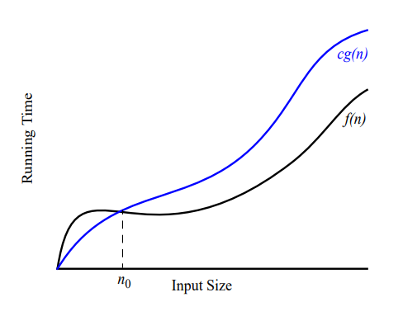

The “Big-Oh” Notation
Given functions f(n) and g(n), we say that:
$f\left(n\right)$ is $O\left(g\left(n\right)\right)$ if and only if
$f\left(n\right)≤c g(n)$ for $n≥n_{0}$

Slide 14
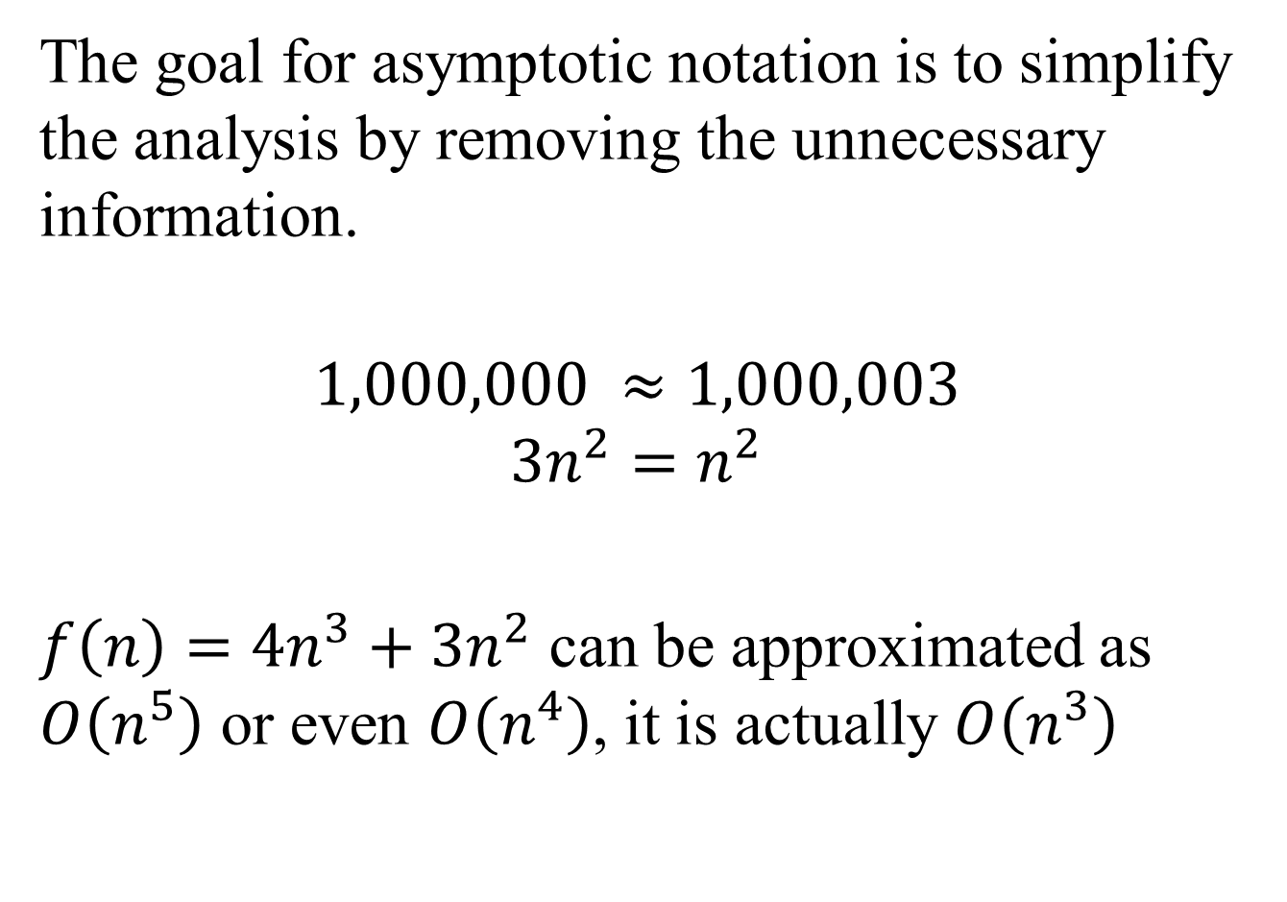
The goal for asymptotic notation is to simplify the analysis by removing the unnecessary information.
$$1,000,000 ≈1,000,003$$
$$3n^{2}=n^{2}$$
$f\left(n\right)=4n^{3}+3n^{2}$ can be approximated as $O\left(n^{5}\right)$ or even $O\left(n^{4}\right)$, it is actually $O\left(n^{3}\right)$

Slide 15
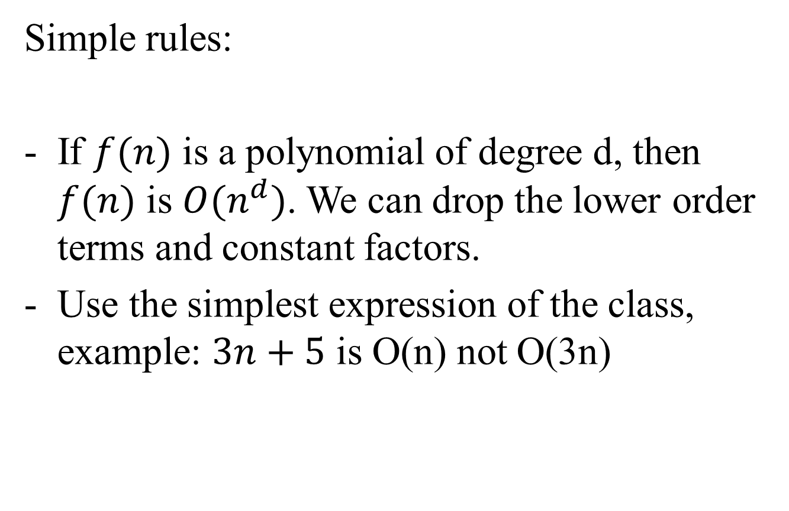
Simple rules:
If $f(n)$ is a polynomial of degree d, then $f(n)$ is $O(n^{d})$. We can drop the lower order terms and constant factors.
Use the simplest expression of the class, example: $3n+5$ is O(n) not O(3n)

Slide 16
Examples:
Is 17 n² – 5 = O(n²)?
Is 35 n³ + 100 = O(n³)?
Is 6 • 2^{n} + n² = O(2^{n})?

Slide 17
Complexity classes
f(n)
n!
2^{n}
n³
n²
n log n
n (linear time)
log n
n
Figure 2. Growth rates of some important complexity classes

Slide 18
Assume that we have a machine that can execute 1,000,000 required operations per sec
 | Algorithm 1 | Algorithm 2 | Algorithm 3 | Algorithm 4 | Algorithm 5
Frequency count | 33n | 6nlogn | 13n² | 3.4n³ | 2^{n}
n=10 n=10,000 | < 1 sec < 1 sec | < 1 sec < 1 sec | < 1 sec 22 min | < 1 sec 39 days | < 1 sec many many centuries
Table 1. Execution time for algorithms with the given time complexities

Slide 19
Note:
log n
n(linear)
n log n polynomial time (easy or tractable)
n²
n³
2^{n}
n!
exponential time (hard or intractable)

Slide 20
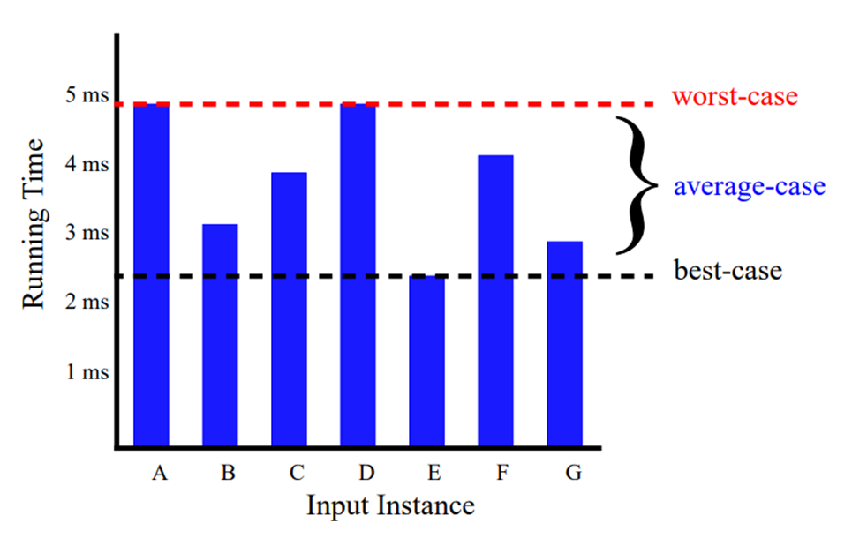
Analysis of Algorithms
Best Case, Worse Case Analysis
An algorithm may run faster on certain data sets than on others,
Finding the average case can be very difficult, so typically algorithms are measured by the worst-case time complexity.
Also, in certain application domains (e.g., air traffic control, surgery) knowing the worst-case time complexity is of crucial importance

